Slide 1

Philadelphia Crimes Analysis
Web Modelling

Slide 2
Team Members
Name | ID
Seif Tarek | 92160070
Eslam Hesham | 92160067
Fares Ashraf | 92160078
Abdel-Majid Ihab | 92160071

Slide 3
Table of Contents
Introduction
Dataset Cleaning & EDA
Time Series
Crimes Classification (Violent/Non-violent)

Slide 4
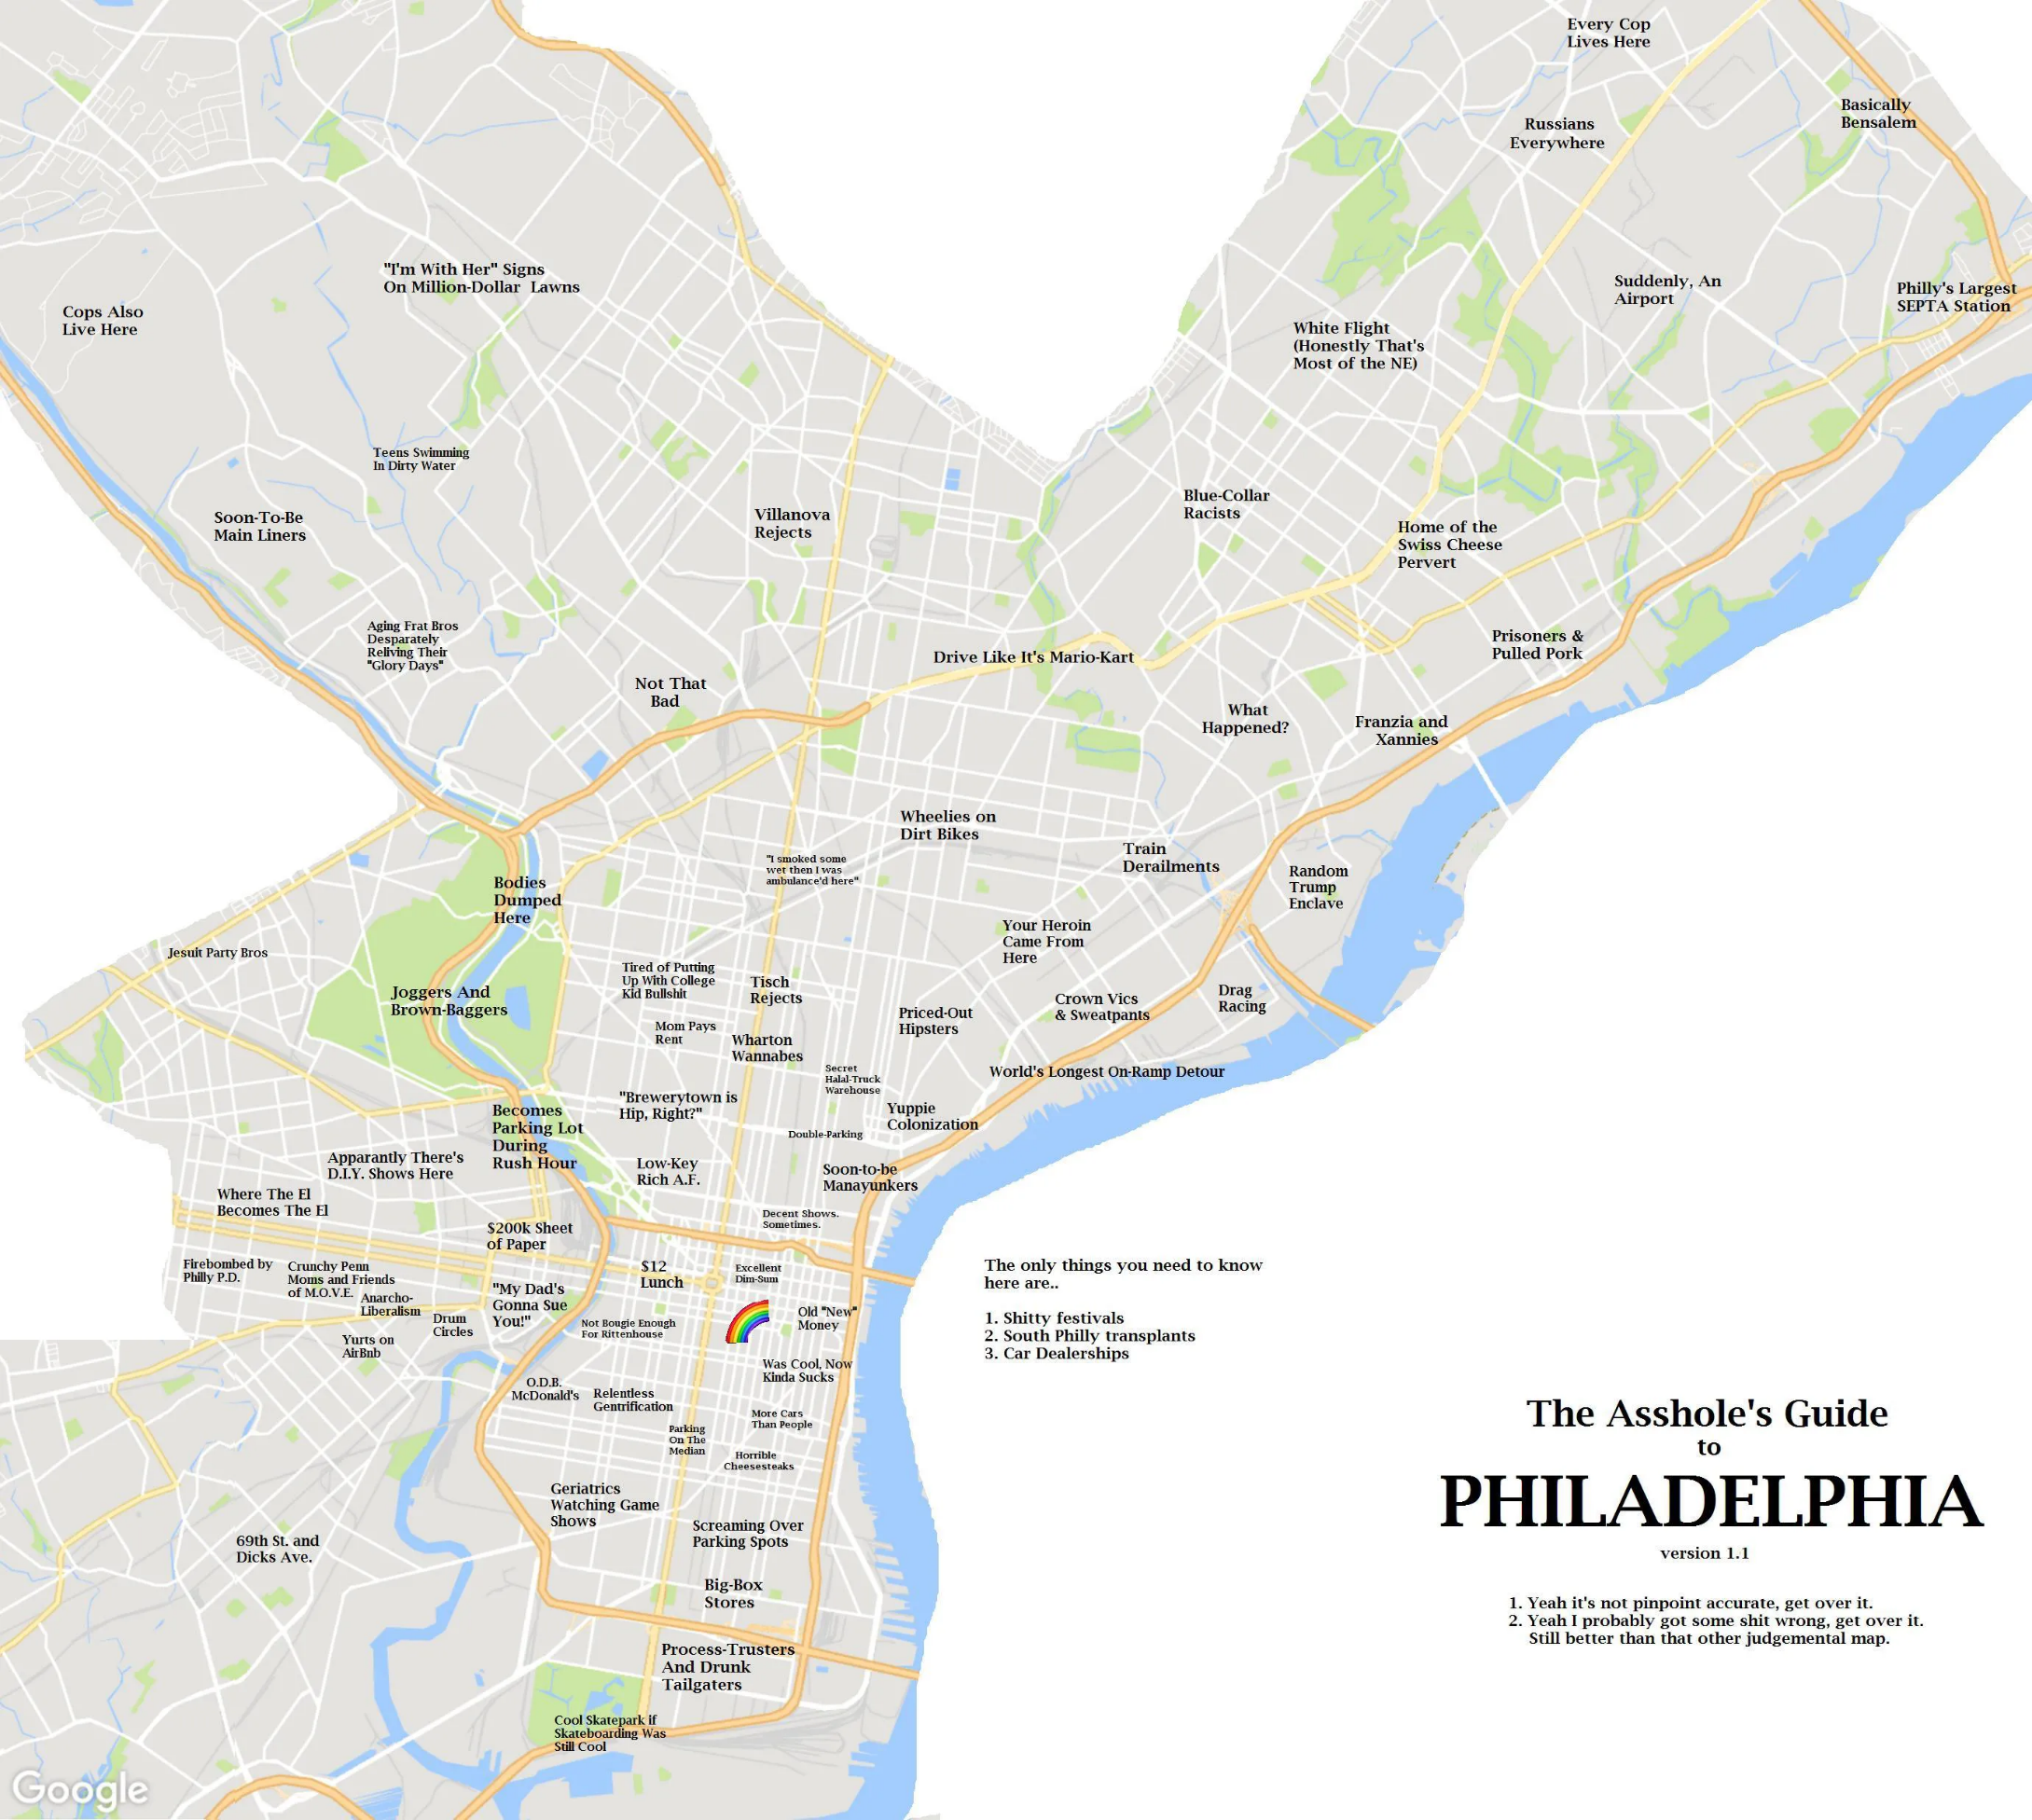
Introduction
Philadelphia, Pennsylvania’s largest city, is notable for its rich history, on display at the Liberty Bell, Independence Hall (where the Declaration of Independence and Constitution were signed), and other American Revolutionary sites. Also iconic are the steps of the Philadelphia Museum of Art, immortalized by Sylvester Stallone’s triumphant run in the film “Rocky.”

Slide 5
Introduction
Problem:
Determine heavy crimes and dangerous places
Committed crime type

Slide 6

Introduction
Solution:
Applying Machine Learning Techniques

Slide 7
Introduction
Machine Learning Techniques:
Time series forecasting
Classification

Slide 8

Dataset Cleaning & EDA
Information about dataset:
Dataset is talking about crimes that happens in Philadelphia and it called “crime incidents”.
Collected dataset is retrieved from “opendataphilly.com”

Slide 9
Dataset Cleaning & EDA
Dataset:
It is a csv file which contains over 2 million records about the crimes that have been done in Philadelphia.
Collected data is from 2006 till 2017

Slide 10
Dataset Cleaning & EDA
Dataset Features:
District ID
Police District Number
UCR Number
Dispatch Date
Location
Crime Type

Slide 11
Dataset Cleaning & EDA
Cleaning:
Removing missing values (Crimes in 2017).
Removing all null values, which were around 9K record.
Converting the format of date in the data set into datetime data type.

Slide 12
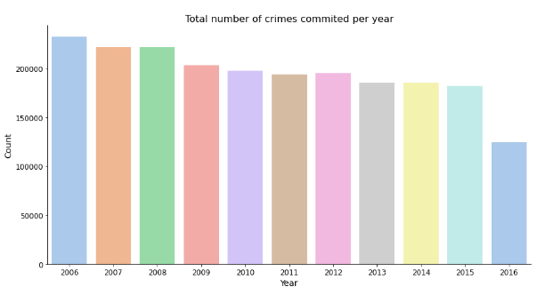
Dataset Cleaning & EDA
EDA (Exploratory Data Analysis):
2006 highest year in crimes
Crimes decreases till 2016 which will be 146000 crime.

Slide 13
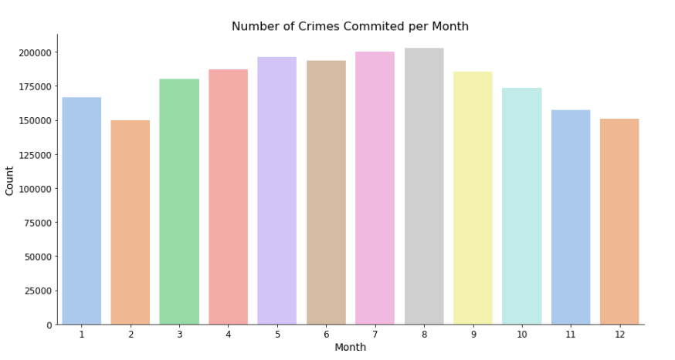
Dataset Cleaning & EDA
EDA (Exploratory Data Analysis):
This graph describing ratio of crimes per year.
As seen crimes decreases at the end of the year in October, September, December.

Slide 14
Dataset Cleaning & EDA
EDA (Exploratory Data Analysis):
This graph describing ratio of crimes per year.
As seen crimes decreases at the end of the year in October, September, December.

Slide 15
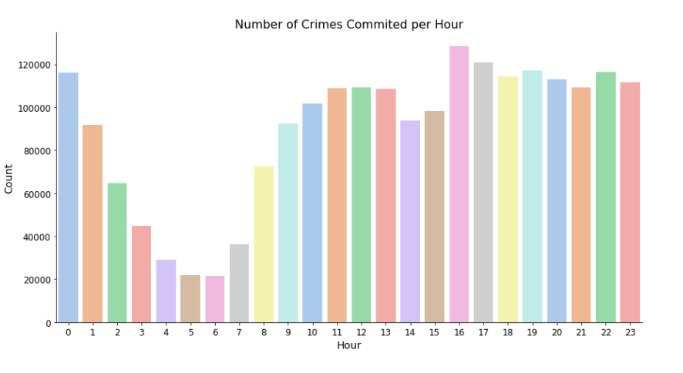
Dataset Cleaning & EDA
EDA (Exploratory Data Analysis):
This graph describing ratio of crimes per day.
As seen that crimes ratio reach to its peak during 16:00 o’clock (04:00 PM)

Slide 16
Dataset Cleaning & EDA
EDA (Exploratory Data Analysis):
This graph describing ratio of crimes per day.
As seen that crimes ratio reach to its bottom during 05:00 o’clock (05:00 AM)

Slide 17
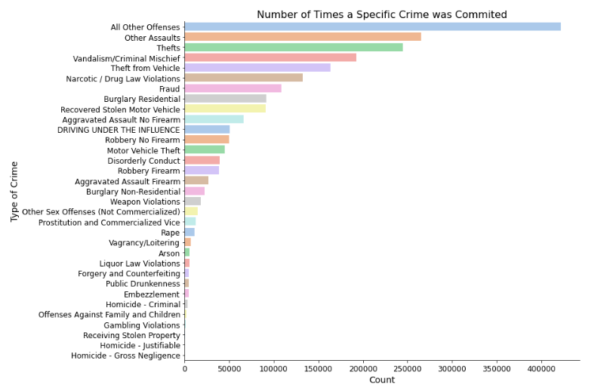
Dataset Cleaning & EDA
EDA (Exploratory Data Analysis):
This graph describing ratio of committed crimes with its name.
As seen, that “Assaults”, and “Thefts” category are the ones committed the most.

Slide 18
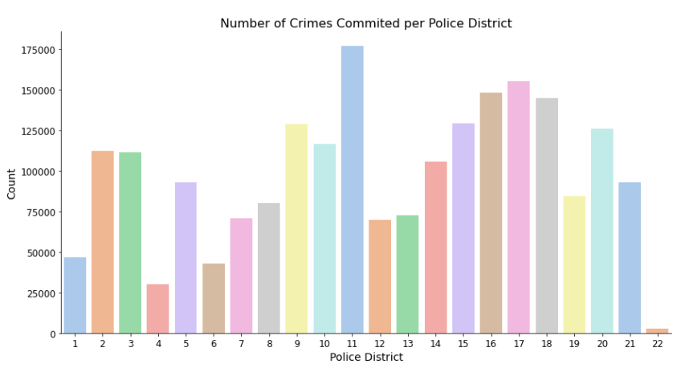
Dataset Cleaning & EDA
EDA (Exploratory Data Analysis):
This graph describing ratio of committed crimes with its police district.
As seen that the most crimes happens in district 11.

Slide 19
Dataset Cleaning & EDA
EDA (Exploratory Data Analysis):
This graph describing ratio of committed crimes with its police district.
As seen that least crimes happens in district 22.

Slide 20
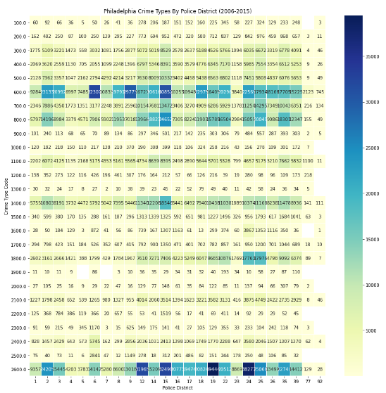
Dataset Cleaning & EDA
EDA (Exploratory Data Analysis):
This bivariate plot shows crime types versus police district.

Slide 21
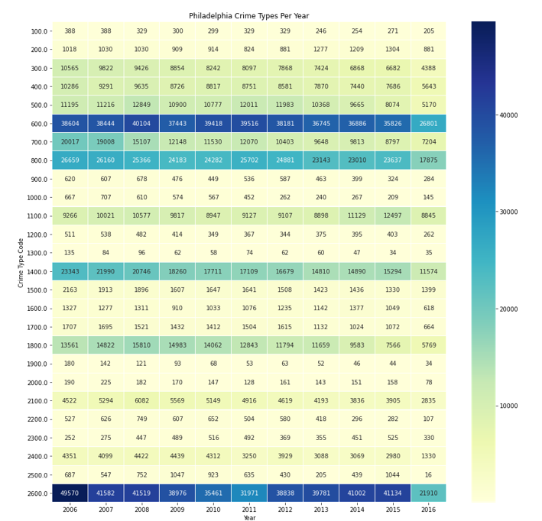
Dataset Cleaning & EDA
EDA (Exploratory Data Analysis):
This bivariate plot shows crimes committed in each year.

Slide 22
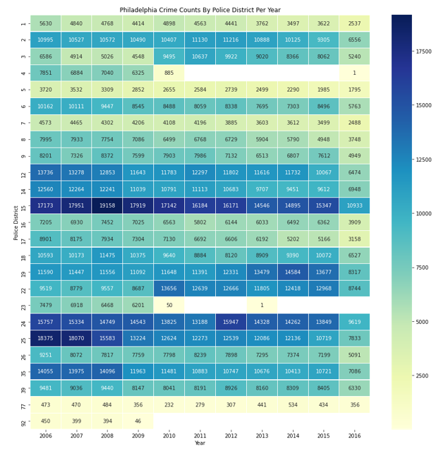
Dataset Cleaning & EDA
EDA (Exploratory Data Analysis):
This bivariate plot shows crimes counts by police district per year.

Slide 23
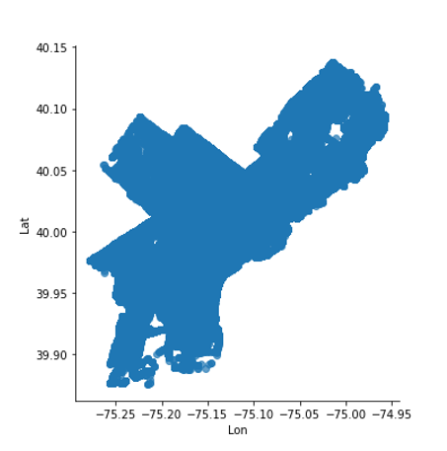
Dataset Cleaning & EDA
EDA (Exploratory Data Analysis):
A plot that shows the location of each crime that was determined by latitude and longitude coordinates.

Slide 24
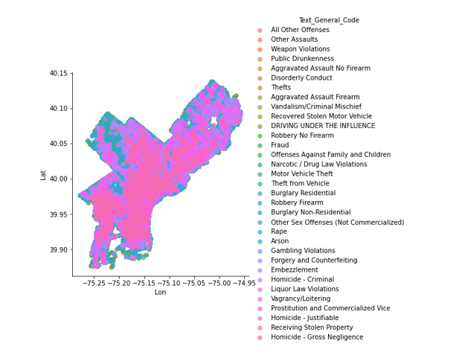
Dataset Cleaning & EDA
EDA (Exploratory Data Analysis):
A plot that shows the location of each crime that was determined by latitude and longitude coordinates, but the points are colored with respect to the crime type.

Slide 25
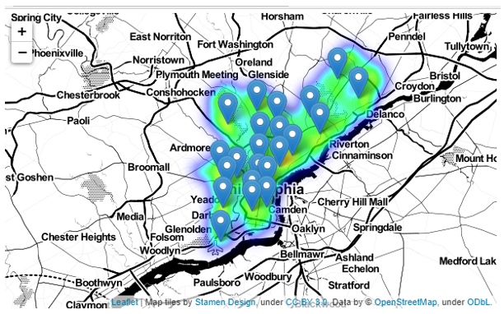
Dataset Cleaning & EDA
EDA (Exploratory Data Analysis):
A live heat map that shows the number of crimes in each zone over the city of Philadelphia along with pins that represents the police districts in city.

Slide 26
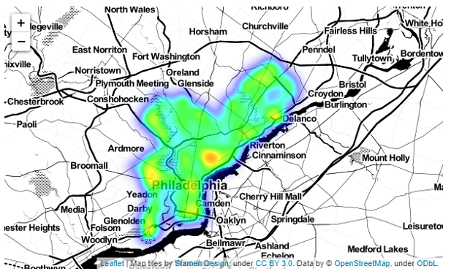
Dataset Cleaning & EDA
EDA (Exploratory Data Analysis):
A live heat map that shows the number of crimes in each zone over the city of Philadelphia, but without the district pins to give a clear view on the numbers of the crimes in each place in the city.

Slide 27
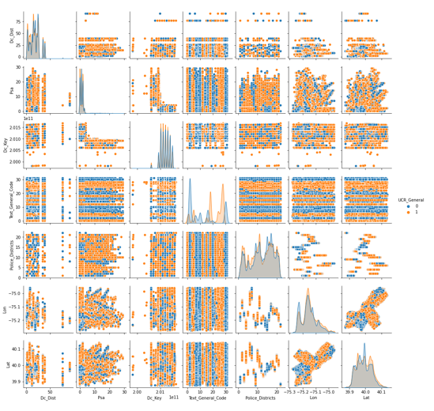
Dataset Cleaning & EDA
EDA (Exploratory Data Analysis):
Pair plot which shows different relationships with the features, and it is colored on the following classes:
Violent Crime
Non-violent Crime

Slide 28
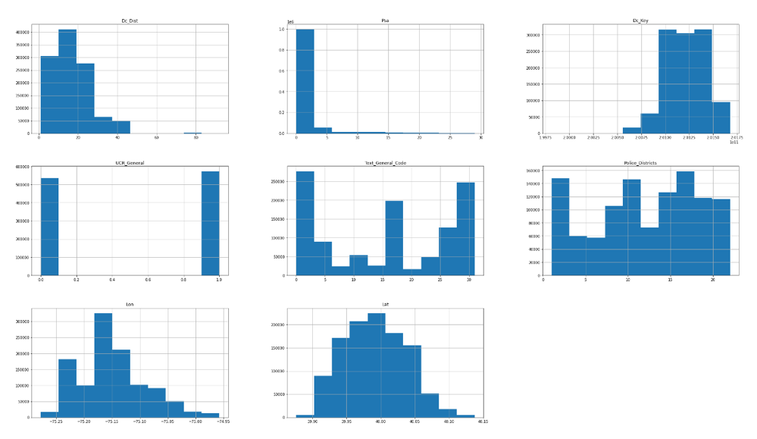
Dataset Cleaning & EDA
EDA (Exploratory Data Analysis):
Histograms for the features to further see the distribution of the feature values among the dataset.

Slide 29
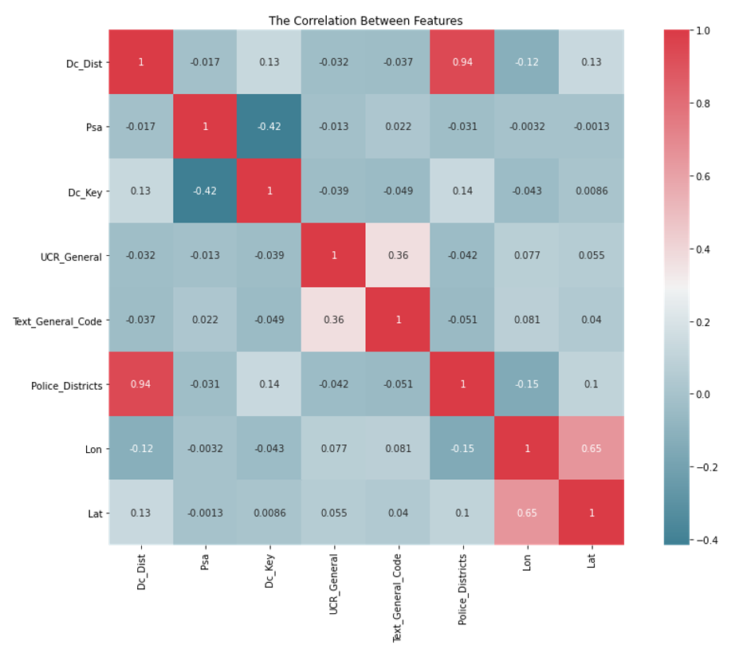
Dataset Cleaning & EDA
EDA (Exploratory Data Analysis):
Correlation matrix which gives insights about how strong the features are related to the target value which is in our case the UCR_General.

Slide 30
Dataset Cleaning & EDA
EDA (Exploratory Data Analysis):
text_general_Code is the feature with the strongest positive correlation with the target value.

Slide 31
Time Series
Time Series Data Visualization
Types:
Line Graph
Bar Graph
Line Graph:
It is the simplest way to represent time series data. It helps the viewer get a quick sense of how something has changed over time.

Slide 32
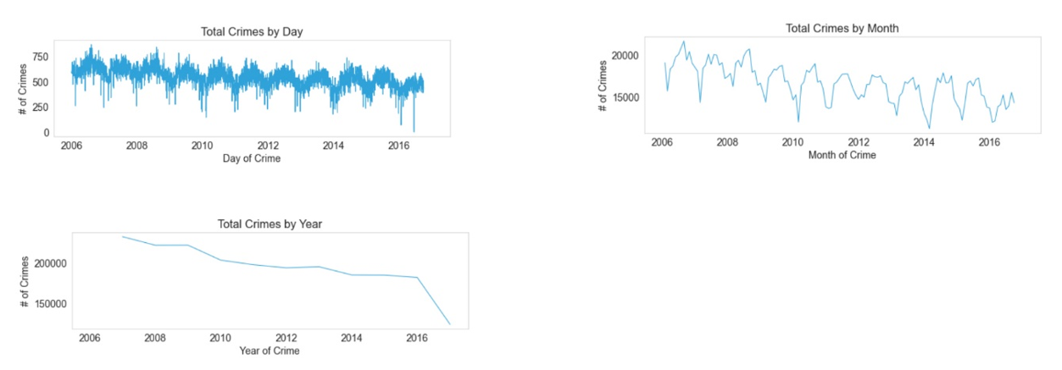
Time Series
Time Series Data Visualization
Number of crimes during period of time

Slide 33
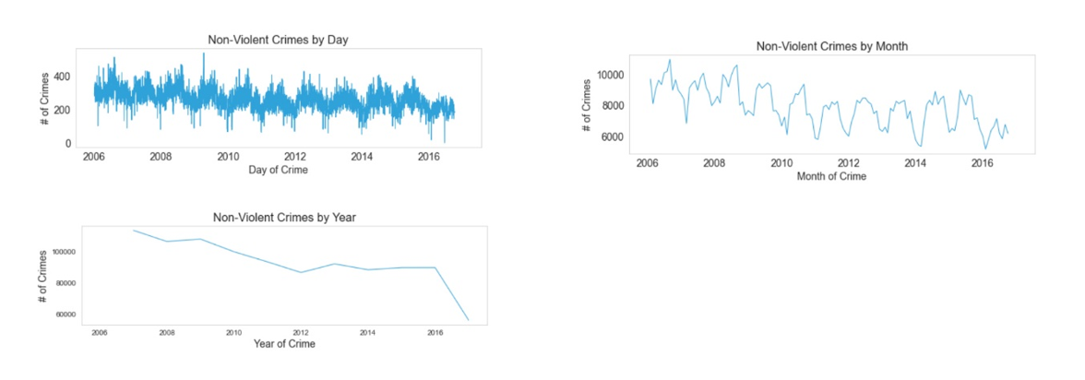
Time Series
Time Series Data Visualization
Number of non-violent crimes during period of time

Slide 34
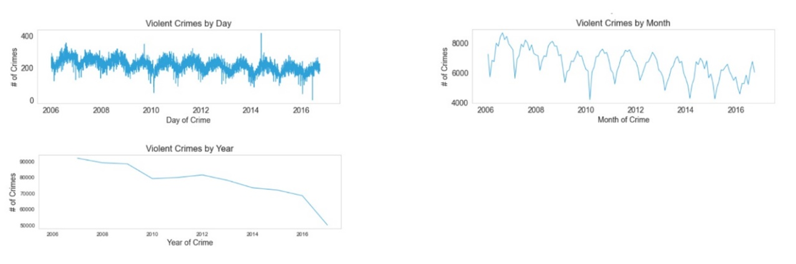
Time Series
Time Series Data Visualization
Number of violent crimes during period of time

Slide 35
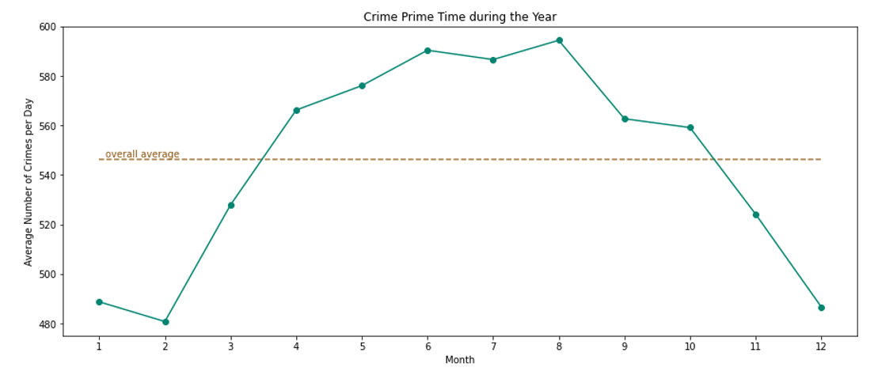
Time Series
Time Series Data Visualization
Graph shows average number of crimes per day versus month.

Slide 36
Time Series
Time Series Data Visualization
Categories of crimes based on time of happening during day:
Biological Rhythm
9-to-5
Night Shift

Slide 37
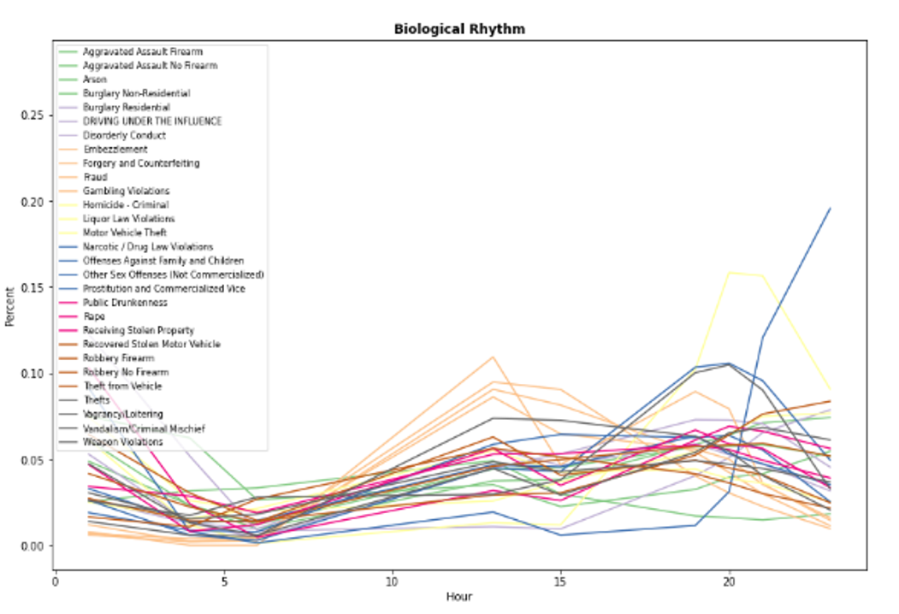
Time Series
Time Series Data Visualization
Categories of crimes based on time of happening during day:
Biological Rhythm

Slide 38
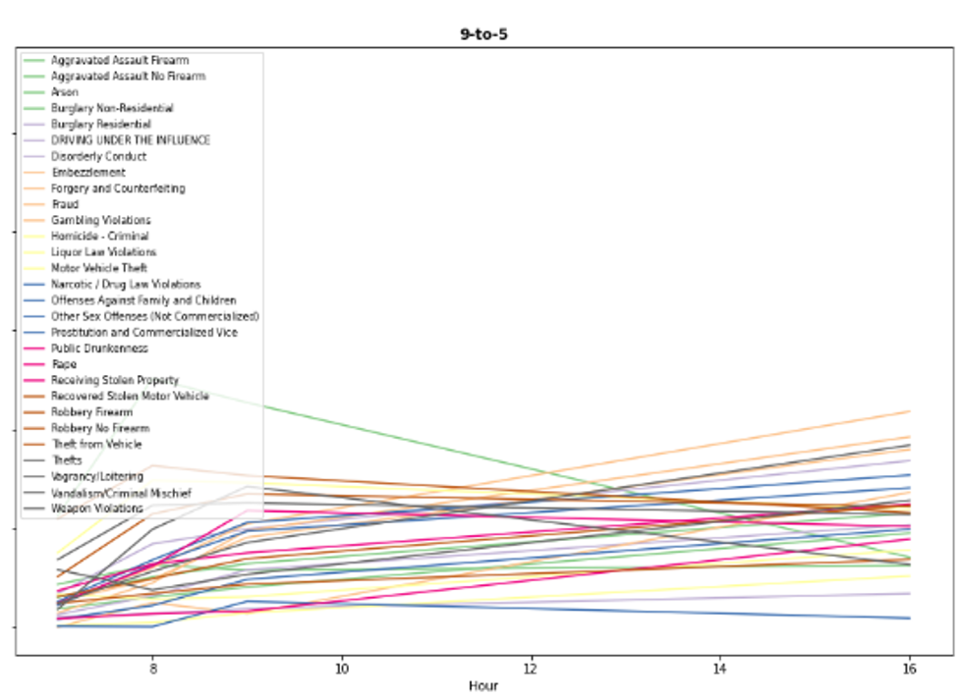
Time Series
Time Series Data Visualization
Categories of crimes based on time of happening during day:
Biological Rhythm
9-to-5

Slide 39
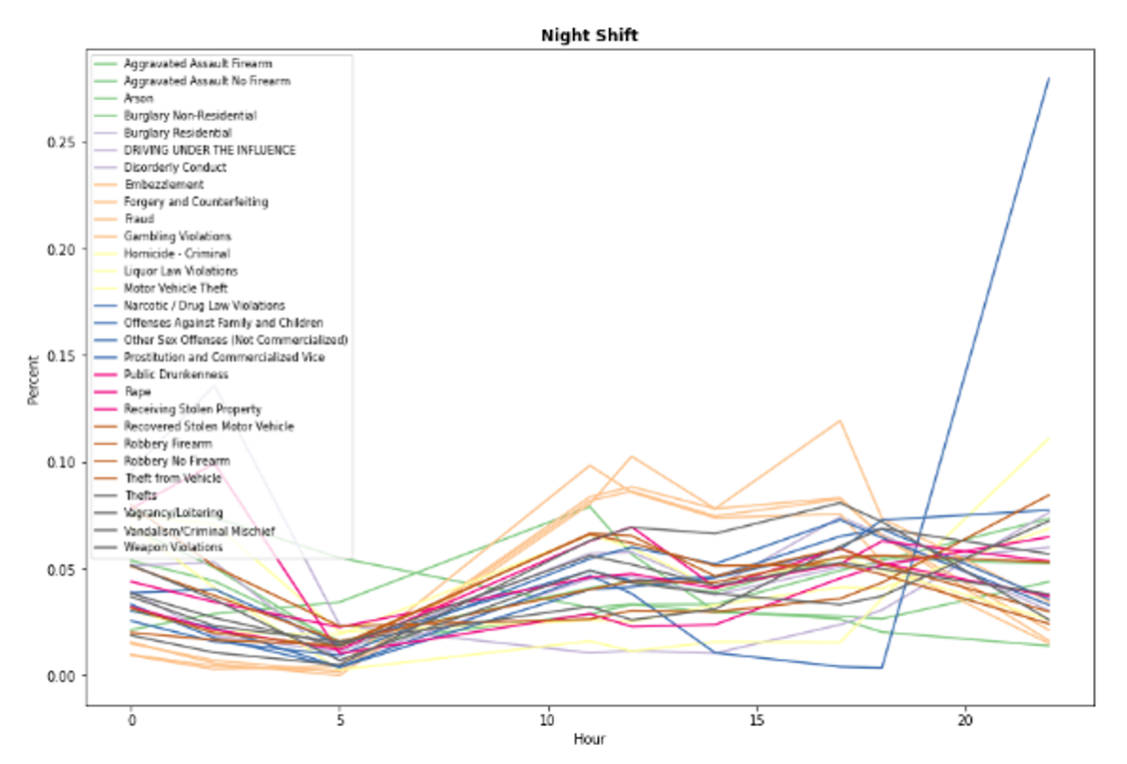
Time Series
Time Series Data Visualization
Categories of crimes based on time of happening during day:
Biological Rhythm
9-to-5
Night Shift

Slide 40
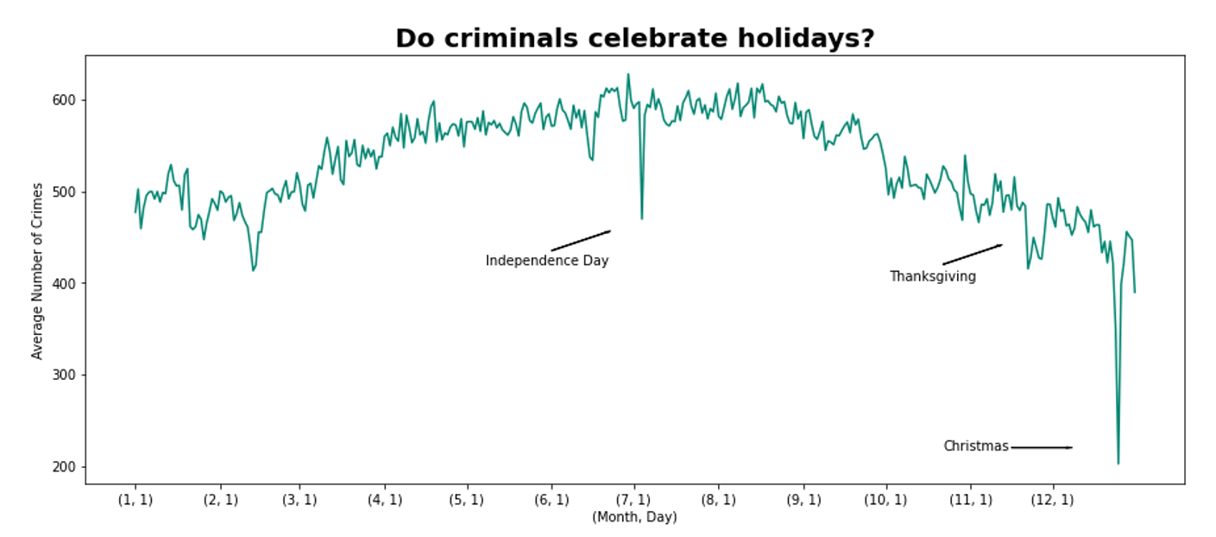
Time Series
Time Series Data Visualization
Graph shows average number of crimes committed during special days such as:
Christmas
4th of July
Independence day
Thanksgiving

Slide 41
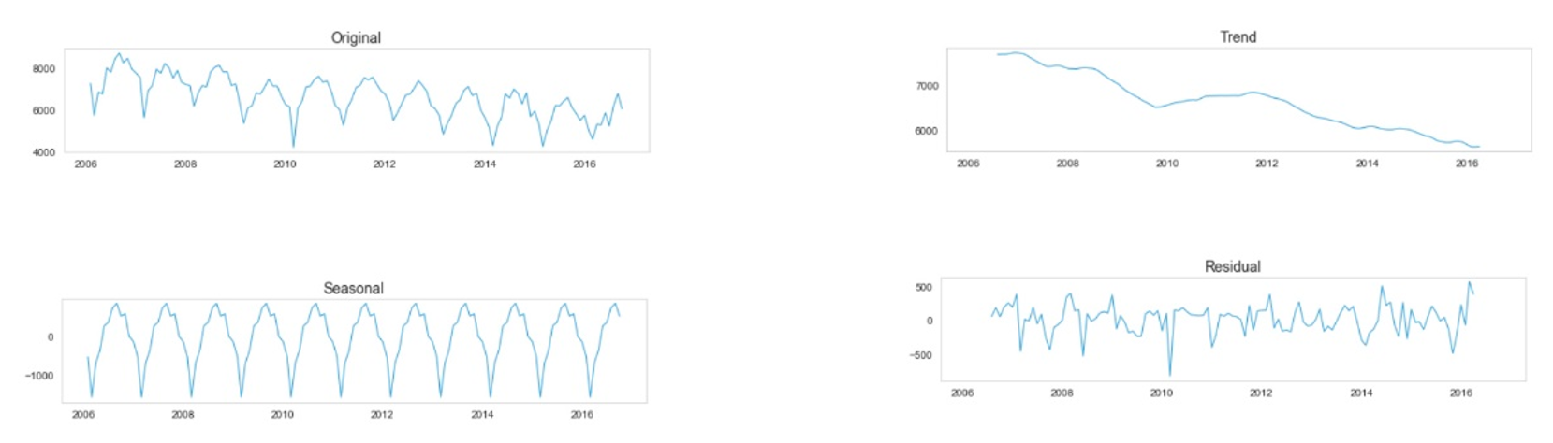
Time Series
Time Series Decomposition
Components of time series:
Level
Trend
Seasonality
Noise / Residuals
These components are classified into:
Systematic
Non – Systematic

Slide 42
Time Series
Preprocessing (Making data stationary):
Why?
Making sure that the predicted values accuracy is high because statistical modeling methods assume or require the time series to be stationary to be effective
How?
Time series could be stationarity throughout freed from trend or any seasonal effects.

Slide 43
Time Series
Preprocessing (Making data stationary):
Methods for testing time series stationarity
Visually
Statistical Measures
Statistical Tests

Slide 44
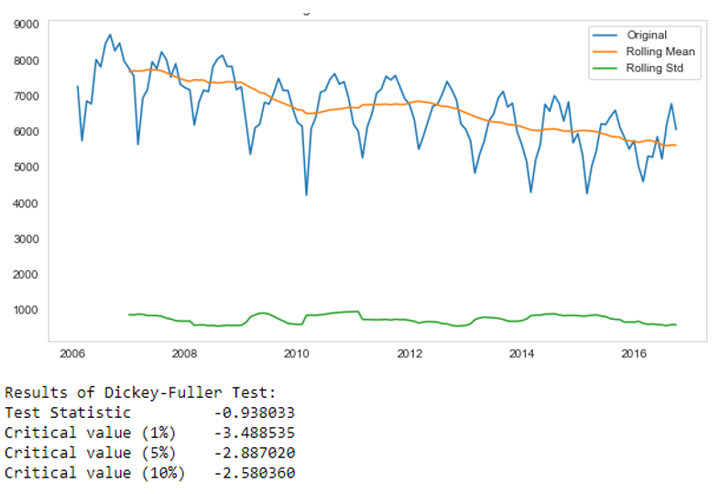
Time Series
Preprocessing (Making data stationary):
Results – From used statistical test (Dickey-Fuller )
As seen, from the represented graph that original data failed in the test
(T-Statistic > Critical value 1% )

Slide 45
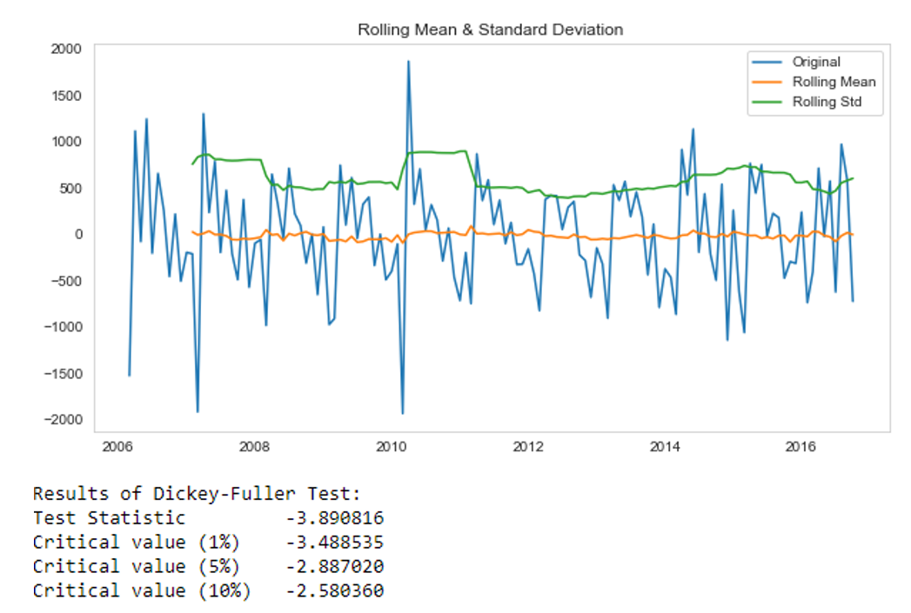
Time Series
Preprocessing (Making data stationary):
Results – From used statistical test (Dickey-Fuller )
As seen, graph is representing testing results of test on the monthly difference
below 1% critical value

Slide 46
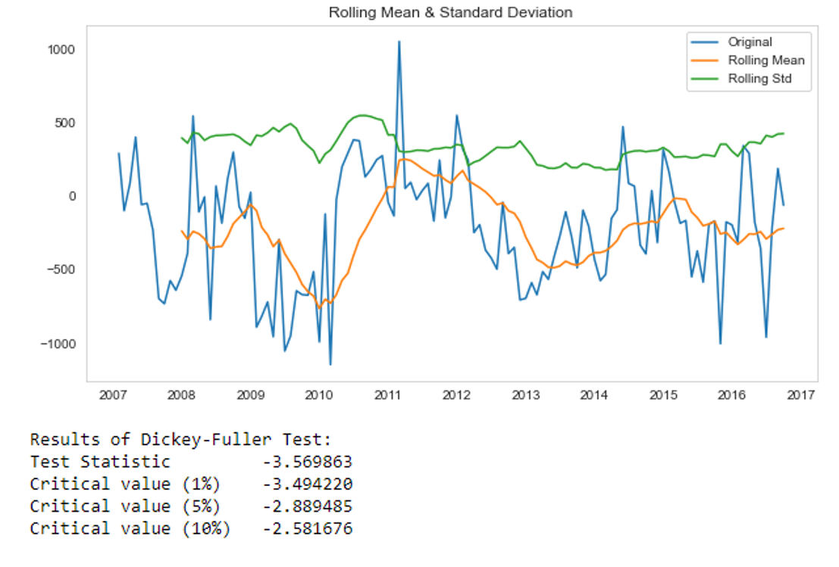
Time Series
Preprocessing (Making data stationary):
Results – From used statistical test (Dickey-Fuller )
As seen, graph is representing testing results of test on seasonality data by applying difference in time of 12

Slide 47
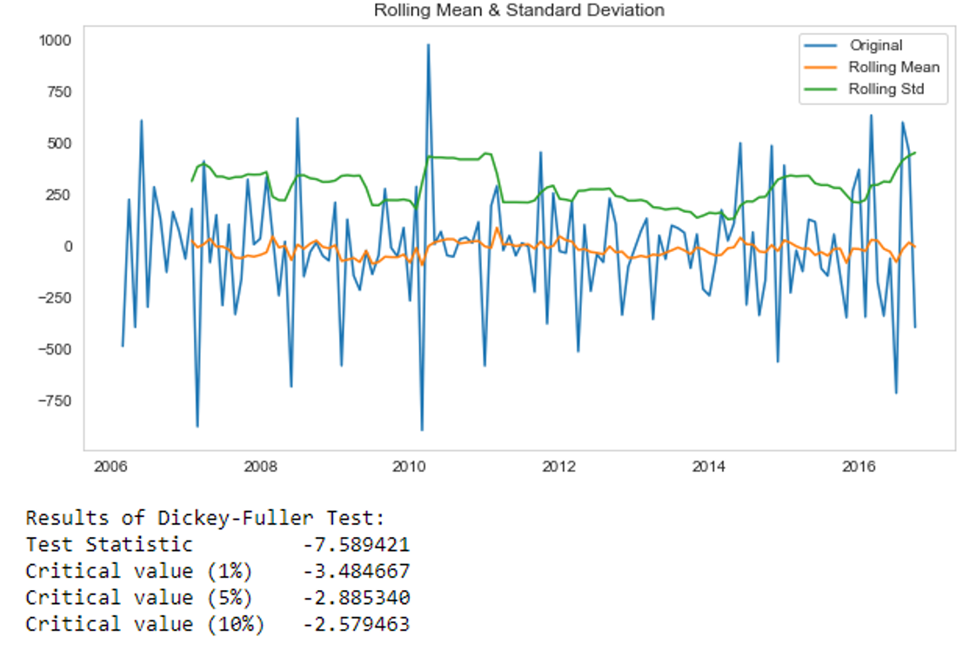
Time Series
Preprocessing (Making data stationary):
Results – From used statistical test (Dickey-Fuller )
As seen, graph is representing testing results of test on seasonality from our seasonal decomposition and use a difference in time of 1
T-statistic is much lower than the critical 1% value

Slide 48
Time Series
ARIM (Autoregressive Integrated Moving Average)
Statistical analysis model that uses time series data to either better understand the data set or to predict future trends.
ARIMA is a method for forecasting or predicting future outcomes based on a historical time series.

Slide 49
Time Series
ARIM (Autoregressive Integrated Moving Average)
Components:
AR (Autoregression): refers to a model that shows a changing variable that regresses on its own lagged, or prior, values.
I (Integrated): represents the differencing of raw observations to allow for the time series to become stationary (i.e., data values are replaced by the difference between the data values and the previous values).
Moving average (MA): Incorporates the dependency between an observation and a residual error from a moving average model applied to lagged observations.

Slide 50
Time Series
ARIM (Autoregressive Integrated Moving Average)
Parameters of each component in “ARIMA” model:
P: The number of lag observations in the model (AR terms), also it is known as the lag order.
d: The number of times that the raw observations are differenced, also known as the degree of differencing.
q: The size of the moving average window (MA terms), also known as the order of the moving average.

Slide 51
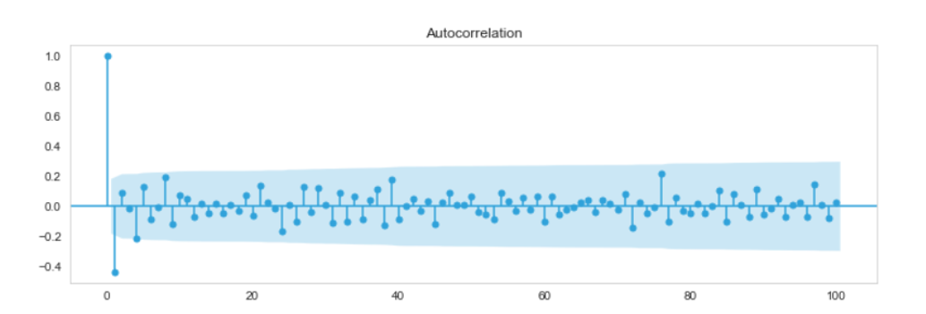
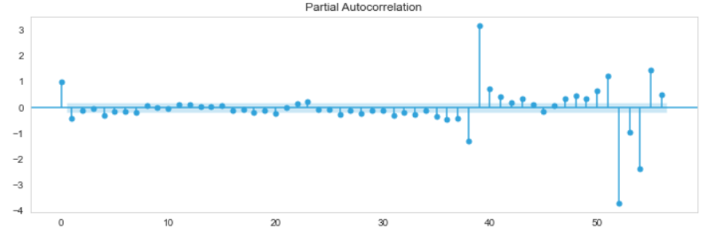
Time Series
ARIM (Autoregressive Integrated Moving Average)
Following to graphs represents that data is already stationary and ready for being feed to ARIM model.

Slide 52
Time Series
ARIM (Autoregressive Integrated Moving Average)
Evaluating the model performance:
Using MAPE (Mean Absolute Percentage Error)
Experiments:
MA Model
AR Model
AR+MA Model

Slide 53
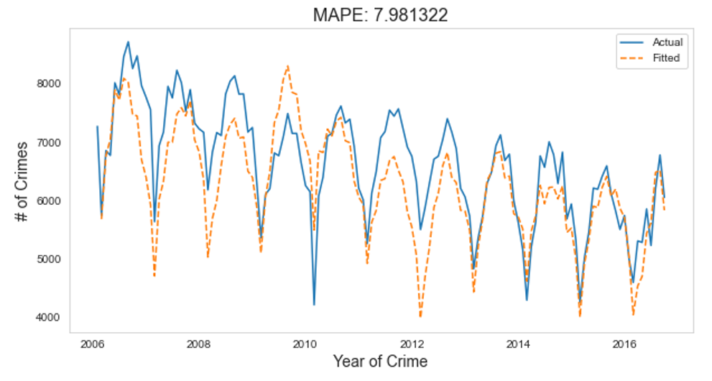
Time Series
ARIM (Autoregressive Integrated Moving Average)
MA Model Result

Slide 54
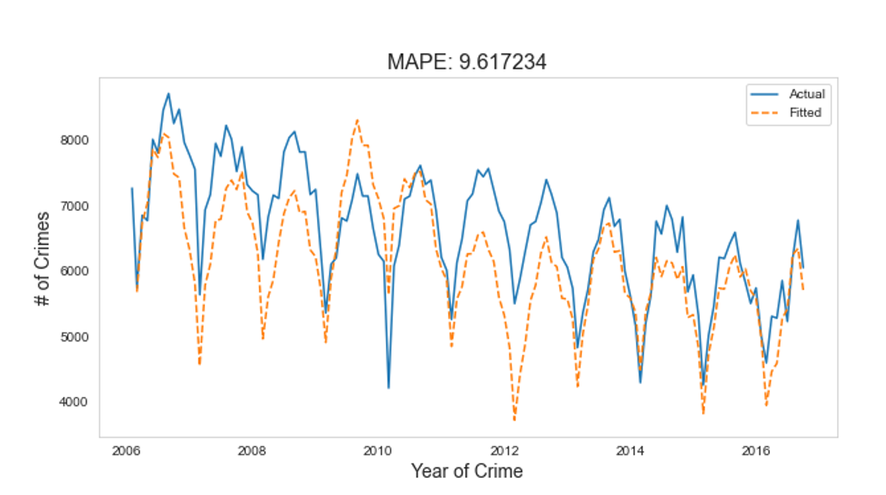
Time Series
ARIM (Autoregressive Integrated Moving Average)
AR Model Result

Slide 55
Time Series
ARIM (Autoregressive Integrated Moving Average)
AR + MA Model Result

Slide 56
Time Series
Crimes Classification (Violent/Non-violent)
Last step is for determining the predicted crimes whether they are violent or not.
Pre-processing on the dataset applied
All the features that were in datetime format were dropped
Half of the data has been taken
Encode all categorical data using label encoding method
UCR_General used as feature distinguishable between classes

Slide 57
Time Series
Crimes Classification (Violent/Non-violent)
Machine Learning Models Training
KNN
SVM
Random Forest

Slide 58
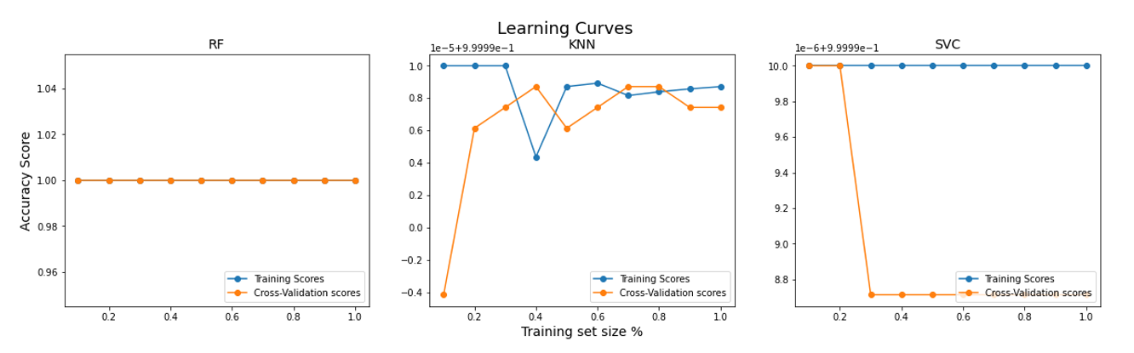
Time Series
Crimes Classification (Violent/Non-violent)
Machine Learning Models Learning Curve
KNN
SVM
Random Forest

Slide 59
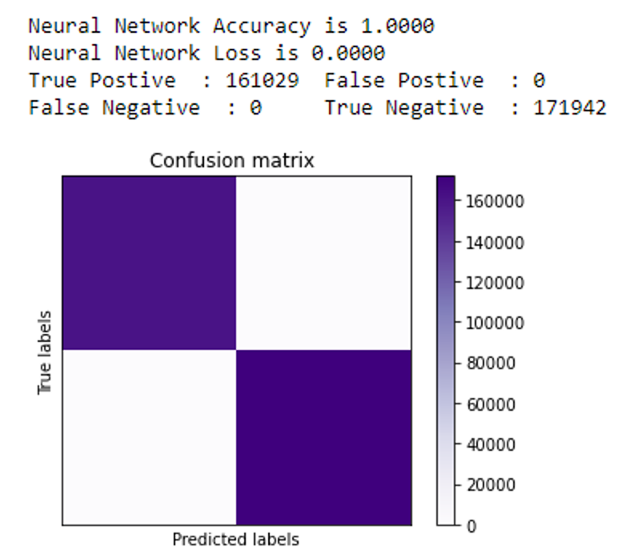
Time Series
Crimes Classification (Violent/Non-violent)
Neural Network Implementation
For validating wether results of machine learning models true or not, MLP has been used.
Results

Slide 60

Thank You

